Slide 1

EFA, Multiple group models & Measurement invariance
Original Lecture by Kimberley lek
Modified by Noémi K. Schuurman

Slide 2

TODAY
F1
CFA/EFA in Mplus
2. latent variable scale
Group 1
Group 2
F1
F1
3. Multigroup in Mplus
4. Measurement invariance

Slide 3
1. CFA / EFA in Mplus
EFA: Exploratory Factor Analysis.
CFA: Confirmatory Factor Analysis.

Slide 4

Factor Analysis: Modeling measurement
of a latent variable.
Both EFA and CFA use a “reflective” measurement model.
Item 77: I enjoy telling funny stories
Extraversion
Item 84: I am a good storyteller
Item 170: I laugh a lot
Item 196: I make others laugh
Notes:
Say we want to measure the latent construct of extraversion, and we believe it is defined by these four items on a questionnaire
(just as in day 1, this example is based on the SOUTH AFRICAN PERSONALITY INVENTORY PROJECT SAPI)

Slide 5
Reflective measurement model
Item 77: I enjoy telling funny stories
Extraversion
Item 84: I am a good storyteller
Item 170: I laugh a lot
Item 196: I make others laugh
Items are the dependent variables, caused by the factor!
Latent variable ‘extraversion’ explain away the correlations among the items.
Notes:
Say we want to measure the latent construct of extraversion, and we believe it is defined by these four items on a questionnaire
(just as in day 1, this example is based on the SOUTH AFRICAN PERSONALITY INVENTORY PROJECT SAPI)

Slide 6
Reflective measurement model
Thermometer 1
Temperature
Thermometer 2
Thermometer 3
Thermometer 4
Note: Thermometer readings are the dependent variables, caused by the temperature!
Notes:
Say we want to measure the latent construct of extraversion, and we believe it is defined by these four items on a questionnaire
(just as in day 1, this example is based on the SOUTH AFRICAN PERSONALITY INVENTORY PROJECT SAPI)

Slide 7
Reflective measurement model
Muscle aches
Virus Infection
Runny Nose
Coughing
Fever
Note: Symptoms are the dependent variables, caused by the virus infection!
Notes:
Say we want to measure the latent construct of extraversion, and we believe it is defined by these four items on a questionnaire
(just as in day 1, this example is based on the SOUTH AFRICAN PERSONALITY INVENTORY PROJECT SAPI)

Slide 8
Formative measurement model
Item 77: I enjoy telling funny stories
Extraversion
Item 84: I am a good storyteller
Item 170: I laugh a lot
Item 196: I make others laugh
Note: Extraversion is the dependent variable, items are the predictors.
Notes:
Say we want to measure the latent construct of extraversion, and we believe it is defined by these four items on a questionnaire
(just as in day 1, this example is based on the SOUTH AFRICAN PERSONALITY INVENTORY PROJECT SAPI)

Slide 9
Formative measurement model
Item 77: I enjoy telling funny stories
Extraversion
Item 84: I am a good storyteller
Item 170: I laugh a lot
Item 196: I make others laugh
Note: Extraversion is defined as a (weighted) sum of the items.
Notes:
Say we want to measure the latent construct of extraversion, and we believe it is defined by these four items on a questionnaire
(just as in day 1, this example is based on the SOUTH AFRICAN PERSONALITY INVENTORY PROJECT SAPI)

Slide 10
Formative measurement model
Residential Neighborhood
Social Economic Status
Salary
Education level
Occupational Prestige
Note: SES is defined as a (weighted) sum of the items.
Notes:
Say we want to measure the latent construct of extraversion, and we believe it is defined by these four items on a questionnaire
(just as in day 1, this example is based on the SOUTH AFRICAN PERSONALITY INVENTORY PROJECT SAPI)

Slide 11
Interesting read on theory & latent variables:
Borsboom, D., Mellenbergh, G. J., & Van Heerden, J. (2003). The theoretical status of latent variables. Psychological review, 110(2), 203.
What about sumscores?
Where we:
Either simply sum all the items score together
Or take a mean of the item scores.
Notes:
Latent variable cannot be observed directly
The researcher must operationally define the latent variable of interest in terms of behavior (items) believed to represent it

Slide 12

Sum scores: SPSS
DATASET ACTIVATE DataSet2.
COMPUTE MEAN_ext=MEAN(Q77,Q84,Q170,Q196).
EXECUTE.
DESCRIPTIVES VARIABLES=MEAN_ext
/STATISTICS=MEAN STDDEV MIN MAX.

Slide 13
Sumscores
Sumscores can be consistent with both reflective and formative measurement models.
Item 77: I enjoy telling funny stories
Extraversion
Item 84: I am a good storyteller
Item 170: I laugh a lot
Item 196: I make others laugh
Item 77: I enjoy telling funny stories
Extraversion
Item 84: I am a good storyteller
Item 170: I laugh a lot
Item 196: I make others laugh
But…Each item gets the same weight!

Slide 14
Sumscores as a
formative measurement model
Item 77: I enjoy telling funny stories
=
Extraversion
Item 84: I am a good storyteller
=
=
Item 170: I laugh a lot
=
Item 196: I make others laugh
Each item is equally important in defining the latent variable.
Notes:
Say we want to measure the latent construct of extraversion, and we believe it is defined by these four items on a questionnaire
(just as in day 1, this example is based on the SOUTH AFRICAN PERSONALITY INVENTORY PROJECT SAPI)

Slide 15
Sumscores as a
reflective measurement model
Item 77: I enjoy telling funny stories
=
Extraversion
=
Item 84: I am a good storyteller
=
Item 170: I laugh a lot
=
Item 196: I make others laugh
Each item is equally reflective of the latent variable.

Slide 16
Factor scores: Mplus
TITLE: Analysis for illustrating mean score vs factor score;
DATA: FILE IS sapi.dat;
VARIABLE:
NAMES ARE id Age EduLevel Gender ReadAb Q44 Q63 Q76 Q77 Q84 Q98 Q170 Q196;
USEVARIABLES ARE Q77 Q84 Q170 Q196;
MISSING ARE ALL(-999);
MODEL:
Extraversion BY Q77 Q84 Q170 Q196;

Slide 17
Factor scores
Item 77: I enjoy telling funny stories
Extraversion
1.00
Item 84: I am a good storyteller
0.708
Item 170: I laugh a lot
0.567
0.742
Item 196: I make others laugh
The ‘factor loadings’ are unequal when estimated with factor analysis.
Items do not seem to be equally reflective of Extraversion.
Notes:
With factor analysis you can determine the extent to which items designed to measure a particular factor (in this case extraversion) actually do so.
It is the ‘true’ correlation between an indicator and a factor
So, every factor (in this case Extraversion) is a weighted sum of the items

Slide 18
Test assumption of equal loadings
MODEL:
Extraversion BY Q77
Q84
Q170 (a)
Q196 (b);
MODEL TEST:
a = b;

Slide 19
Test assumption of equal loadings
MODEL:
Extraversion BY Q77
Q84
Q170 (a)
Q196 (b);
MODEL TEST:
a = b;
Wald Test of Parameter Constraints
Value 13.558
Degrees of Freedom 1
P-Value 0.0002

Slide 20
Intermezzo:
Categorical or continuous indicators?

Slide 21
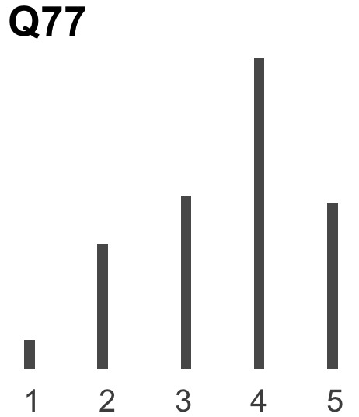
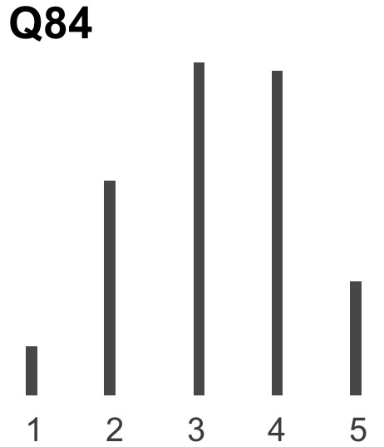
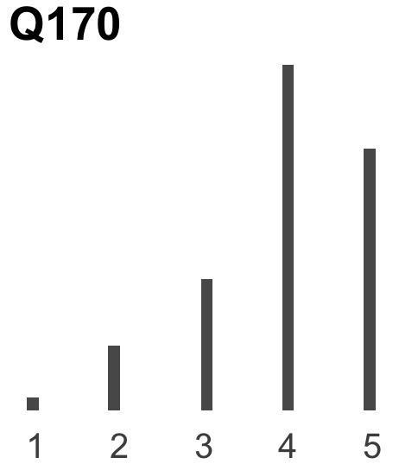
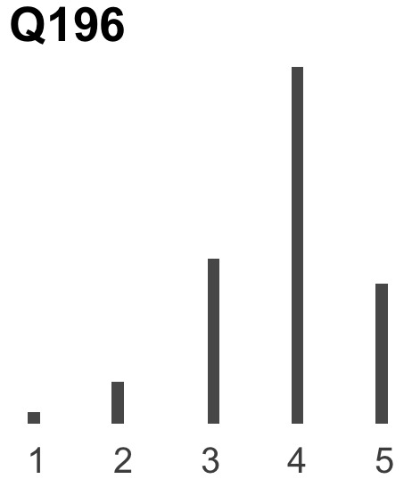
ORDINAL

Slide 22
Categorical
TITLE: Analysis for illustrating categorical vs continuous;
DATA: FILE IS Sapi.dat;
ANALYSIS: estimator = ML; !to obtain AIC and BIC fit indices
VARIABLE:
NAMES ARE id Age EduLevel Gender ReadAb Q44 Q63 Q76 Q77 Q84 Q98 Q170 Q196;
USEVARIABLES ARE Q77 Q84 Q170 Q196 ;
MISSING ARE ALL(-999);
CATEGORICAL ARE ALL;
MODEL:
Extraversion BY Q77
Q84
Q170
Q196 ;

Slide 23
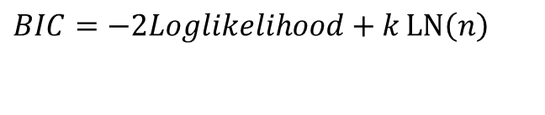
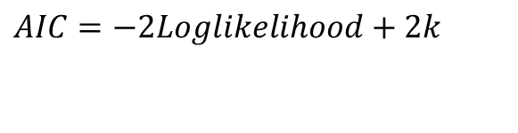
Note: Don’t use Chi2 tests or IC to compare categorical and continuous models
Based on combining goodness of fit (-2Loglikelihood) and parsimony (k = # of parameters)
No rule of thumb, values depend on actual data set. Choose the model with the lowest AIC and/or BIC
NOTE: Cannot compare likelihoods of categorical and continuous indicator models. Likelihood incomparable.
(also obviously not nested)
$$AIC=−2Loglikelihood+2k$$
$$BIC=−2Loglikelihood+k\operatorname{LN}\left(n\right)$$

Slide 24
Notes:
Observed variable y is seen as a partial observation of continuous variable y* ; y* is the exact but unobserved dependent variable
Area under the curve is the probability of observing y=1, y =2, etc.
When y* is below threshold 1, the observed y = 1
When there are no exogenous variables in the model, it is simply about converting the cumulative proportions to z-scores; otherwise the Threshold model is comparable to an ordered probit regression model
The cut-points 1, 2, …,4, have usually been treated as nuisance parameters, and although their estimates are usually reported, their values are rarely given interpretation.

Slide 25
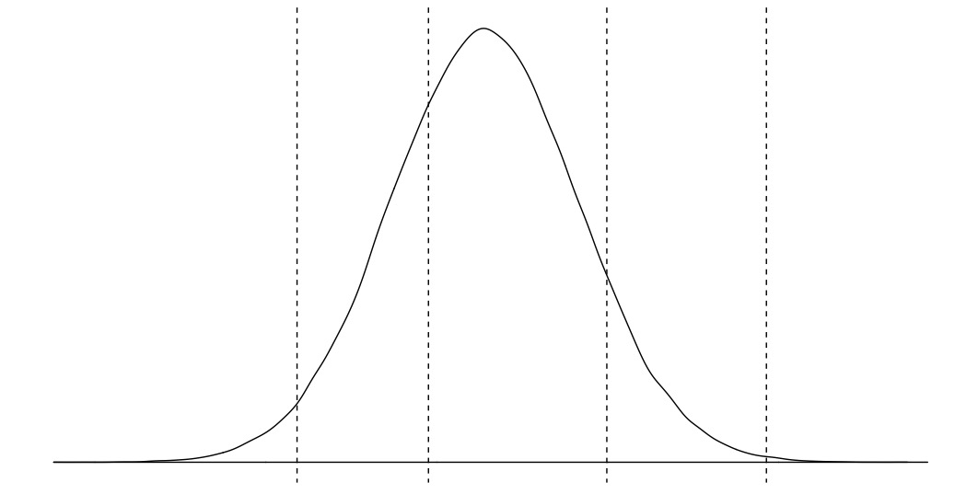
Threshold 1
Threshold 2
Threshold 3
Threshold 4
Threshold 1
y=1
y=2
y=3
y=4
y=5
Y*
Default is essentially an ordinal (ordered) probit resgression model.
Also an option: consider IRT models (logistic regression models).
Notes:
Observed variable y is seen as a partial observation of continuous variable y* ; y* is the exact but unobserved dependent variable
Area under the curve is the probability of observing y=1, y =2, etc.
When y* is below threshold 1, the observed y = 1
When there are no exogenous variables in the model, it is simply about converting the cumulative proportions to z-scores; otherwise the Threshold model is comparable to an ordered probit regression model
The cut-points 1, 2, …,4, have usually been treated as nuisance parameters, and although their estimates are usually reported, their values are rarely given interpretation.

Slide 26
MODEL RESULTS
Estimate S.E. Est./S.E. P-Value
EXTRAVER BY
Q77 1.000 0.000 999.000 999.000
Q84 0.556 0.056 9.925 0.000
Q170 0.522 0.072 7.216 0.000
Q196 1.032 0.161 6.407 0.000
Thresholds
Q77$1 -5.317 0.354 -15.021 0.000
Q77$2 -2.594 0.196 -13.240 0.000
Q77$3 -0.721 0.123 -5.845 0.000
Q77$4 2.397 0.187 12.816 0.000
...
Q196$3 -1.543 0.155 -9.947 0.000
Q196$4 2.570 0.201 12.780 0.000
Variances
EXTRAVERSI 5.579 1.025 5.443 0.000

Slide 27
Interesting Reading:
Muthén, B. (1984). A general structural equation model with dichotomous, ordered categorical, and continuous latent variable indicators. Psychometrika, 49(1), 115-132.
Rhemtulla, M., Brosseau-Liard, P. É., & Savalei, V. (2012). When can categorical variables be treated as continuous? A comparison of robust continuous and categorical SEM estimation methods under suboptimal conditions. Psychological Methods, 17(3), 354–373.
Svetina, D., Rutkowski, L., & Rutkowski, D. (2020). Multiple-group invariance with categorical outcomes using updated guidelines: an illustration using M plus and the lavaan/semtools packages. Structural Equation Modeling: A Multidisciplinary Journal, 27(1), 111-130.
Notes:
Observed variable y is seen as a partial observation of continuous variable y* ; y* is the exact but unobserved dependent variable
Area under the curve is the probability of observing y=1, y =2, etc.
When y* is below threshold 1, the observed y = 1
When there are no exogenous variables in the model, it is simply about converting the cumulative proportions to z-scores; otherwise the Threshold model is comparable to an ordered probit regression model
The cut-points 1, 2, …,4, have usually been treated as nuisance parameters, and although their estimates are usually reported, their values are rarely given interpretation.

Slide 28
Confirmatory or exploratory?

Slide 29
Two subscales of extraversion
Item 77: I enjoy telling funny stories
Having fun
Item 84: I am a good storyteller
Item 170: I laugh a lot
Item 196: I make others laugh
Item 44: I am liked by everyone
Being liked
Item 63: I chat to everyone
Item 76: I have many friends
Item 98: I have good social skills

Slide 30
CFA: hypothesized loadings
Item 77: I enjoy telling funny stories
Having fun
Item 84: I am a good storyteller
Item 170: I laugh a lot
Item 196: I make others laugh
Item 44: I am liked by everyone
Being liked
Item 63: I chat to everyone
Item 76: I have many friends
Item 98: I have good social skills
Notes:
Hypothesis-testing approach to data analysis
Based on theory, empirical research or a combination of both, the researcher postulates a model and then tests for its validity given the sample data.
With the model above, we hypothesize a priori that:
Responses to the items 77,84,170,196,44,63,76 and 98 can be explained by two factors: ‘having fun’ and ‘being liked’
(b) Each of the items 77, 84, 170 and 196 have a nonzero loading on the ‘having fun’ factor they were designed to measure and a zero loading on the ‘being liked’ factor
(c) Each of the items 44, 63, 76 and 98 have a nonzero loading on the ‘being liked’ factor they were designed to measure and a zero loading on the ‘having fun’ factor
(d) the two factors ‘having fun’ and ‘being liked’ are correlated
And (e) that the residuals associated with each indicator item variable are uncorrelated

Slide 31
EFA: cross-loadings
Item 77: I enjoy telling funny stories
Having fun
Item 84: I am a good storyteller
Item 170: I laugh a lot
Item 196: I make others laugh
Item 44: I am liked by everyone
Being liked
Item 63: I chat to everyone
Item 76: I have many friends
Item 98: I have good social skills
Notes:
With EFA you evaluate/estimate all loadings, and you can investigate the number of underlying latent constructs according to the data. EFA is most appropriate for assessment instruments that are still in the initial stages of development
With CFA you constrain some loadings to be zero, and the number of factors is fixed.

Slide 32
EFA: cross-loadings
USEVARIABLES ARE
Q77
Q84
Q170
Q196
Q44
Q63
Q76
Q98
;
MISSING ARE ALL(-999);
ANALYSIS: TYPE = EFA 2 2;

Slide 33
EFA: cross-loadings
USEVARIABLES ARE
Q77
Q84
Q170
Q196
Q44
Q63
Q76
Q98
;
MISSING ARE ALL(-999);
ANALYSIS: TYPE = EFA 2 2;
MODEL:
EMPTY

Slide 34
EFA: cross-loadings
GEOMIN ROTATED LOADINGS
(* significant at 5% level)
1 2
________ ________
Q77 0.803* -0.008
Q84 0.458* 0.189*
Q170 0.336* 0.201*
Q196 0.591* 0.151*
Q44 -0.187* 0.629*
Q63 0.001 0.578*
Q76 0.016 0.512*
Q98 0.086 0.542*
Notes:
By default, Mplus provides a geomin rotated solution. (Geomin is an oblique type of rotation, so the correlations between the factors are given in the output.)

Slide 35
EFA: cross-loadings
GEOMIN ROTATED LOADINGS
(* significant at 5% level)
1 2
________ ________
Q77 0.803* -0.008
Q84 0.458* 0.189*
Q170 0.336* 0.201*
Q196 0.591* 0.151*
Q44 -0.187* 0.629*
Q63 0.001 0.578*
Q76 0.116 0.512*
Q98 0.086 0.542*

Slide 36
EFA: cross-loadings
GEOMIN ROTATED LOADINGS
(* significant at 5% level)
1 2
________ ________
Q77 0.803* -0.008
Q84 0.458* 0.189*
Q170 0.336* 0.201*
Q196 0.591* 0.151*
Q44 -0.187* 0.629*
Q63 0.001 0.578*
Q76 0.116 0.512*
Q98 0.086 0.542*

Slide 37
EFA: cross-loadings
MODEL FIT INFORMATION
RMSEA (Root mean Square Error Of Approximation)
Estimate 0.077
90 Percent C.I. 0.062 0.092
Probability RMSEA <= .05 0.002
CFI/TLI
CFI 0.951
TLI 0.895

Slide 38
EFA: cross-loadings
GEOMIN FACTOR CORRELATIONS (* significant at 5% level)
1 2
________ ________
1 1.000
2 0.576* 1.000

Slide 39
CFA: force cross-loadings to zero
Item 77: I enjoy telling funny stories
Having fun
Item 84: I am a good storyteller
Item 170: I laugh a lot
Item 196: I make others laugh
Item 44: I am liked by everyone
Being liked
Item 63: I chat to everyone
Item 76: I have many friends
Item 98: I have good social skills

Slide 40
CFA: force cross-loadings to zero
MODEL:
FUN BY Q77
Q84
Q170
Q196
Q44@0
Q63@0
Q76@0
Q98@0;
LIKED BY Q77@0
Q84@0
Q170@0
Q196@0
Q44
Q63
Q76
Q98;
FUN WITH LIKED;

Slide 41
CFA: use Mplus defaults
MODEL:
FUN BY Q77
Q84
Q170
Q196 ;
LIKED BY Q44
Q63
Q76
Q98;
Notes:
Fun with liked is also default

Slide 42
CFA: use Mplus defaults
MODEL FIT INFORMATION
RMSEA (Root Mean Square Error Of Approximation)
Estimate 0.074
90 Percent C.I. 0.062 0.087
Probability RMSEA <= .05 0.001
CFI/TLI
CFI 0.933
TLI 0.901
Notes:
Fun with liked is also default

Slide 43
CFA: use Mplus defaults
STANDARDIZED MODEL RESULTS
Estimate S.E.
FUN BY
Q77 0.734 0.023
Q84 0.578 0.027
Q170 0.504 0.029
Q196 0.719 0.023
LIKED BY
Q44 0.461 0.033
Q63 0.589 0.030
Q76 0.522 0.031
Q98 0.619 0.029
FUN WITH
LIKED 0.682 0.034
Notes:
The correlation can be found under standardized model results. It is now higher, because the factors are built up differently

Slide 44
CFA: use Mplus defaults
VARIABLE: IDVARIABLE IS id;
SAVEDATA:
SAVE IS fscores;
FILE IS cfa.dat;
Notes:
The factors scores for each subject can be saved

Slide 45
CFA: modification indices
Blending the confirmatory with exploratory
OUTPUT: MODINDICES;
M.I. E.P.C. Std E.P.C. StdYX E.P.C.
BY Statements
FUN BY Q44 11.853 -0.255 -0.203 -0.221
LIKED BY Q77 12.564 -0.586 -0.249 -0.229
LIKED BY Q84 13.080 0.551 0.234 0.222
WITH Statements
Q84 WITH Q77 35.426 0.194 0.194 0.305
Q170 WITH Q77 12.873 -0.104 -0.104 -0.166
Q170 WITH Q84 20.428 -0.123 -0.123 -0.170
Q196 WITH Q84 31.132 -0.144 -0.144 -0.276
Q196 WITH Q170 36.276 0.138 0.138 0.271
Q44 WITH Q77 10.621 -0.078 -0.078 -0.129
Q98 WITH Q84 16.530 0.092 0.092 0.156
Notes:
Model misspecification -> confirmatory followed by exploratory changes
Interesting at this moment are:
non-zero loadings on non-target factors (factor cross-loadings)
Non-zero values for the residual covariances (systematic measurement error)
Residual covariances can be caused by characteristics either specific to the items or the respondents
Small omitted factor
Respondent bias such as yeasaying/naysaying, social desirability et cetera
(high) degree of overlap in item content (essentially the same question, but worded differently)
Information given in the table:
MI => if this parameter were to be freely estimated, the overall chi-square statistic could decrease by approximately this amount
EPC => expected parameter change, represents the approximate value that a parameter is expected to attain should it be subsequently estimated
In this case, ………………………………..
IMPORTANT! Post hoc model fitting is dangerous; exploratory nature. Model respecification must ALWAYS be supported by strong substantive and/or empirical rationale. Keep in mind that, ideally, items on a measurement instrument should clearly target only one of its underlying constructs.
Always take the issue of scientific parsimony into account. Danger of chance capitalization
Some attempts to address this issue with type 1 error adjustment procedures, such as Bonferroni-type corrections (p. 120-121 Byrne, 2012).
Always a good idea: cross-validation.

Slide 46
CFA: modification indices
OUTPUT: MODINDICES;
M.I. E.P.C. Std E.P.C. StdYX E.P.C.
BY Statements
FUN BY Q44 11.853 -0.255 -0.203 -0.221
LIKED BY Q77 12.564 -0.586 -0.249 -0.229
LIKED BY Q84 13.080 0.551 0.234 0.222
WITH Statements
Q84 WITH Q77 35.426 0.194 0.194 0.305
Q170 WITH Q77 12.873 -0.104 -0.104 -0.166
Q170 WITH Q84 20.428 -0.123 -0.123 -0.170
Q196 WITH Q84 31.132 -0.144 -0.144 -0.276
Q196 WITH Q170 36.276 0.138 0.138 0.271
Q44 WITH Q77 10.621 -0.078 -0.078 -0.129
Q98 WITH Q84 16.530 0.092 0.092 0.156
Cross-loadings
Residual covariances
Notes:
Model misspecification -> confirmatory followed by exploratory changes
Interesting at this moment are:
non-zero loadings on non-target factors (factor cross-loadings)
Non-zero values for the residual covariances (systematic measurement error)
Residual covariances can be caused by characteristics either specific to the items or the respondents
Small omitted factor
Respondent bias such as yeasaying/naysaying, social desirability et cetera
(high) degree of overlap in item content (essentially the same question, but worded differently)
Information given in the table:
MI => if this parameter were to be freely estimated, the overall chi-square statistic could decrease by approximately this amount
EPC => expected parameter change, represents the approximate value that a parameter is expected to attain should it be subsequently estimated
In this case, ………………………………..
IMPORTANT! Post hoc model fitting is dangerous; exploratory nature. Model respecification must ALWAYS be supported by strong substantive and/or empirical rationale. Keep in mind that, ideally, items on a measurement instrument should clearly target only one of its underlying constructs.
Always take the issue of scientific parsimony into account.

Slide 47
CFA: modification indices
OUTPUT: MODINDICES;
DANGER!
Capitalization on chance
M.I. E.P.C. Std E.P.C. StdYX E.P.C.
BY Statements
FUN BY Q44 11.853 -0.255 -0.203 -0.221
LIKED BY Q77 12.564 -0.586 -0.249 -0.229
LIKED BY Q84 13.080 0.551 0.234 0.222
WITH Statements
Q84 WITH Q77 35.426 0.194 0.194 0.305
Q170 WITH Q77 12.873 -0.104 -0.104 -0.166
Q170 WITH Q84 20.428 -0.123 -0.123 -0.170
Q196 WITH Q84 31.132 -0.144 -0.144 -0.276
Q196 WITH Q170 36.276 0.138 0.138 0.271
Q44 WITH Q77 10.621 -0.078 -0.078 -0.129
Q98 WITH Q84 16.530 0.092 0.092 0.156
Cross-loadings
Residual covariances
Notes:
Model misspecification -> confirmatory followed by exploratory changes
Interesting at this moment are:
non-zero loadings on non-target factors (factor cross-loadings)
Non-zero values for the residual covariances (systematic measurement error)
Residual covariances can be caused by characteristics either specific to the items or the respondents
Small omitted factor
Respondent bias such as yeasaying/naysaying, social desirability et cetera
(high) degree of overlap in item content (essentially the same question, but worded differently)
Information given in the table:
MI => if this parameter were to be freely estimated, the overall chi-square statistic could decrease by approximately this amount
EPC => expected parameter change, represents the approximate value that a parameter is expected to attain should it be subsequently estimated
In this case, ………………………………..
IMPORTANT! Post hoc model fitting is dangerous; exploratory nature. Model respecification must ALWAYS be supported by strong substantive and/or empirical rationale. Keep in mind that, ideally, items on a measurement instrument should clearly target only one of its underlying constructs.
Always take the issue of scientific parsimony into account.

Slide 48
CFA: modification indices
MODEL:
FUN BY Q77
Q84
Q170
Q196 ;
LIKED BY Q44
Q63
Q76
Q98;
Q196 WITH Q170;
Notes:
Input
Addition of freely estimated parameters to the model
NOTE: only add one parameter at a time to the model, as the MI values can change substantially from one tested parameterization to another (estimation of Mis in Mplus is based on univariate approach)
Start with largest MI
Model fit
Once the model is estimated with the freely estimated extra parameter, you can determine the difference in fit between the models to see whether it is statistically significant
The difference between chi-squares is itself chi-square distributed
Degrees of freedom equal to the difference in degrees of freedom
Output
Note that the estimated value for .. Is exactly in tune with the predicted EPC value

Slide 49
CFA: modification indices
Chi-Square Test of Model Fit
Value 124.170
Degrees of Freedom 19
P-Value 0.0000
Chi-Square Test of Model Fit
Value 88.738
Degrees of Freedom 18
P-Value 0.0000
$∆χ^{2}$ 124.170 – 88.738 = 35.432
$∆$df 19 – 18 = 1
Notes:
Input
Addition of freely estimated parameters to the model
NOTE: only add one parameter at a time to the model, as the MI values can change substantially from one tested parameterization to another (estimation of Mis in Mplus is based on univariate approach)
Start with largest MI
Model fit
Once the model is estimated with the freely estimated extra parameter, you can determine the difference in fit between the models to see whether it is statistically significant
The difference between chi-squares is itself chi-square distributed
Degrees of freedom equal to the difference in degrees of freedom
Output
Note that the estimated value for .. Is exactly in tune with the predicted EPC value

Slide 50
CFA: modification indices
Q196 WITH
Q170 0.137 0.024 5.687 0.000
M.I. E.P.C. Std E.P.C. StdYX E.P.C.
WITH Statements
Q84 WITH Q77 35.426 0.194 0.194 0.305
Q170 WITH Q77 12.873 -0.104 -0.104 -0.166
Q170 WITH Q84 20.428 -0.123 -0.123 -0.170
Q196 WITH Q84 31.132 -0.144 -0.144 -0.276
Q196 WITH Q170 36.276 0.138 0.138 0.271
Q44 WITH Q77 10.621 -0.078 -0.078 -0.129
Q98 WITH Q84 16.530 0.092 0.092 0.156
Notes:
Input
Addition of freely estimated parameters to the model
NOTE: only add one parameter at a time to the model, as the MI values can change substantially from one tested parameterization to another (estimation of Mis in Mplus is based on univariate approach)
Start with largest MI
Model fit
Once the model is estimated with the freely estimated extra parameter, you can determine the difference in fit between the models to see whether it is statistically significant
The difference between chi-squares is itself chi-square distributed
Degrees of freedom equal to the difference in degrees of freedom
Output
Note that the estimated value for .. Is exactly in tune with the predicted EPC value

Slide 51
CFA: cross-loading approximately 0
Problem:
Restricting cross-loadings to exactly 0 can be too strict
Consequence: rejection of the model, model modifications that capitalize on chance
(Possible) solution in Bayesian SEM (BSEM):
Replace exact zero restrictions with approximate ones
Using Bayesian small-variance priors
Interesting reading:
Muthén, B., & Asparouhov, T. (2012). Bayesian structural equation modeling: A more flexible representation of substantive theory. Psychological Methods, 17(3), 313-335.

Slide 52
2. Latent variable scale

Slide 53
Background
Because latent variables are not observed, they do not have an inherent scale
Therefore, we have to set up the model in such a way that the scale of the latent variables is clear
Item 77: I enjoy telling funny stories
Extraversion
Item 84: I am a good storyteller
Item 170: I laugh a lot
Item 196: I make others laugh

Slide 54
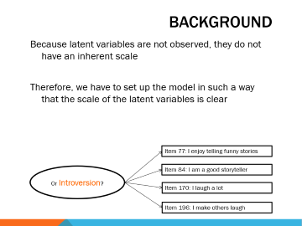
Background
Because latent variables are not observed, they do not have an inherent scale
Therefore, we have to set up the model in such a way that the scale of the latent variables is clear
Item 77: I enjoy telling funny stories
Or Introversion?
Item 84: I am a good storyteller
Item 170: I laugh a lot
Item 196: I make others laugh

Slide 55
Three Common Ways
Constrain one of the factor loadings (Mplus default)
Constrain the factor variance
Constrain the average of the loadings
Item 77: I enjoy telling funny stories
Extraversion
Item 84: I am a good storyteller
Item 170: I laugh a lot
Item 196: I make others laugh
Notes:
Note: each method of identification is simply an alternative but equivalent parameterization of the same model!

Slide 56
1. Default Parameterization:
Marker-variable method
Ψ
MODEL: F1 BY y1@1 y2 y3;
[F1@0];
Default parameterization:
First factor loading constrained at 1
Factor mean constrained at zero
Other defaults:
Mean of residuals is by definition 0
Residuals have a loading of 1
Estimated:
Factor variance (Ψ), other factor loadings (λ₂, λ₃), item intercepts (ν₁, ν₂, ν₃), residual variances (ε₁, ε₂, ε₃)
0
F1
1
λ₂
λ₃
y₁
y₂
y₃
1
1
1
0
0
0
e₁
e₂
e₃
ε₁
ε₂
ε₃
Notes:
This is an illustration of how Mplus identifies a latent construct by default.
In pink/light red the syntax which you do not have to specify explicitly, but which Mplus uses in the background.
This method is similar to the analysis of variance dummy-coding model. As with dummy coding, the choice of which indicator to fix is somewhat arbitrary.

Slide 57
1. Default Parameterization:
Marker-variable method
TITLE: Parameterization 1;
DATA: FILE IS Sapi_Demo.dat;
VARIABLE: NAMES = ID Age EduLevel Gender ReadAb Q44
Q63 Q76 Q77 Q84 Q98 Q170 Q196;
USEVARIABLES = Q77 Q84 Q170 Q196 ;
MISSING = ALL(-999);
MODEL: Extraversion BY Q77 Q84 Q170 Q196;
OUTPUT: SAMPSTAT STDYX TECH1

Slide 58
1. Default Parameterization:
Marker-variable method
MODEL RESULTS
Estimate S.E. Est./S.E. P-Value
EXTRAVER BY
Q77 1.000 0.000 999.000 999.000
Q84 0.708 0.047 15.213 0.000
Q170 0.567 0.052 10.996 0.000
Q196 0.742 0.052 14.179 0.000
Means
EXTRAVER 0.000 0.000 999.000 999.000
Intercepts
Q77 3.571 0.034 103.670 0.000
Q84 3.224 0.033 96.473 0.000
Q170 3.947 0.031 127.447 0.000
Q196 3.800 0.028 137.530 0.000
Variances
EXTRAVER 0.696 0.064 10.825 0.000

Slide 59
1. Default Parameterization:
Marker-variable method
MODEL RESULTS
Estimate S.E. Est./S.E. P-Value
EXTRAVER BY
Q77 1.000 0.000 999.000 999.000
Q84 0.708 0.047 15.213 0.000
Q170 0.567 0.052 10.996 0.000
Q196 0.742 0.052 14.179 0.000
Means
EXTRAVER 0.000 0.000 999.000 999.000
Intercepts
Q77 3.571 0.034 103.670 0.000
Q84 3.224 0.033 96.473 0.000
Q170 3.947 0.031 127.447 0.000
Q196 3.800 0.028 137.530 0.000
Variances
EXTRAVER 0.696 0.064 10.825 0.000
The factor loading of the first indicator is constrained to 1, all other factor loadings are interpreted relative to the constrained item.
If the reference category were changed, the loadings would also change.

Slide 60
2. REFERENCE GROUP METHOD
MODEL: F1 BY y1* y2 y3;
F1@1;
[F1@0];
Constrains factor mean to 0, factor variance to 1
Estimated:
All factor loadings (λ_{1,} λ₂, λ₃), all intercepts (ν₁, ν₂, ν₃), all residual variances (ε₁, ε₂, ε₃)
1
0
F1
λ₁
λ₂
λ₃
y₁
y₂
y₃
1
1
1
0
0
0
e₁
e₂
e₃
ε₁
ε₂
ε₃
The asterisk after y1 tells Mplus to estimate this factor loading
Notes:
This is what spss does.
You release the constraint with the asterisk.
The advantage: you estimate all three factor loadings. They are not relative only.
You get all intercepts.
NOTE: if you have MULTIPLE groups – as we will be working with in the rest of the lecture – the latent mean and variance are ONLY fixed for
Each construct in the first group / at the first occassion
That is: with invariance of the loadings and intercepts in place, the estimates of the latent means and variances of the constructs in subsequent groups are identified and scaled
Relative to the fixed mean and variance in the first group
So the latent mean of a construct in each consequent group is the weighted average difference across the set of indicators of the construct. That is, the differences in indicator means are weighted by the factor loadings
The estimated latent variance of a construct in each subsequent group reflects the proportional differences in the common variance of the indicators explained by a given construct
That is why it is called the ‘reference group’ method

Slide 61
2. REFERENCE GROUP METHOD
TITLE: Parameterization 2;
DATA: FILE IS Sapi_Demo.dat;
VARIABLE: NAMES = ID Age EduLevel Gender ReadAb Q44 Q63 Q76 Q77 Q84 Q98 Q170 Q196;
USEVARIABLES = Q77 Q84 Q170 Q196 ;
MISSING = ALL(-999);
MODEL: Extraversion BY Q77* Q84 Q170 Q196;
Extraversion@1;
[Extraversion@0];
OUTPUT: SAMPSTAT STDYX TECH1

Slide 62
2. REFERENCE GROUP METHOD
Two-Tailed
Estimate S.E. Est./S.E. P-Value
EXTRAVER BY
Q77 0.835 0.039 21.651 0.000
Q84 0.591 0.036 16.294 0.000
Q170 0.473 0.035 13.361 0.000
Q196 0.619 0.031 20.055 0.000
Means
EXTRAVERSI 0.000 0.000 999.000 999.000
Intercepts
Q77 3.571 0.034 103.670 0.000
Q84 3.224 0.033 96.473 0.000
Q170 3.947 0.031 127.448 0.000
Q196 3.800 0.028 137.530 0.000
Variances
EXTRAVERSI 1.000 0.000 999.000 999.000
Notes:
The results are standardized on the latent factor.

Slide 63
2. REFERENCE GROUP METHOD
Two-Tailed
Estimate S.E. Est./S.E. P-Value
EXTRAVER BY
Q77 0.835 0.039 21.651 0.000
Q84 0.591 0.036 16.294 0.000
Q170 0.473 0.035 13.361 0.000
Q196 0.619 0.031 20.055 0.000
Means
EXTRAVERSI 0.000 0.000 999.000 999.000
Intercepts
Q77 3.571 0.034 103.670 0.000
Q84 3.224 0.033 96.473 0.000
Q170 3.947 0.031 127.448 0.000
Q196 3.800 0.028 137.530 0.000
Variances
EXTRAVERSI 1.000 0.000 999.000 999.000
The advantage of this method is that all factor loadings are estimated and that the factor scores are placed on a standardized metric
Notes:
The results are standardized on the latent factor.

Slide 64
WHICH METHOD TO CHOOSE?
1
2
Marker-variable
Reference group
Ψ
Ψ@1
α@0
α@0
F1
F1
1
λ₂
λ₃
λ₁
λ₂
λ₃
y₁
y₂
y₃
y₁
y₂
y₃
1
1
1
1
1
1
0
0
0
0
0
0
e₁
e₂
e₃
e₁
e₂
e₃
ε₁
ε₂
ε₃
ε₁
ε₂
ε₃
Does not matter for your substantive conclusions.
Sometimes, pragmatic reasons for choosing one over the other.
Notes:
Note: if you have only one group, the reference group has the advantage of estimating the association between the latent constructs in correlational metric, which is a readily interpretable metric to gauge the strength of associations between constructs
Marker variable: estimated means and variances of the latent constructs vary depending on which indicator is chosen as the marker variable

Slide 65
A THIRD METHOD
Constrain the average of the factor loadings to 1 and the average of the item intercepts to 0 (Little, Slegers, & Card, 2006)
Using these constraints, each of the factor loadings and each of the means are estimated.
Interpretations can be intuitive: Factor on similar scale as the indicators.
Factor variance: Average variance of each indicator that can be explained by the factor.
Factor mean: weighted mean of the indicator means.
Notes:
This method uses the effects constraints to provide an optimal balance across the possible indicators to establish the scale of the estimated parameters, where the average intercept is zero but no individual manifest intercept is fixed to be zero. Similarly, the loading parameters are estimated as an optimal balance around 1.0, but no individual loading is necessarily constrained to be 1.0.
This method results in estimates of the latent variances that are the average of the indicator’s variances accounted for by the construct, and the latent means are estimated as optimally weighted averages of the set of indicator means for a given construct.
In other words, the estimated latent variances and latent means reflect the observed metric of the indicators, optimally weighted by the degree to which each indicator represents the underlying latent construct.
(see p. 63 Little et al., 2006)

Slide 66
3. EFFECTS-CODING
MODEL: F1 BY y1* y2 y3 (a b c);
[y1 y2 y3] (d e f);
[F1]; !not estimated by default
MODEL CONSTRAINT:
a = 3 – b – c; !3 = # of parameters
d = 0 – e – f;
Estimated:
All loadings, variances, means.
Ψ
α
F1
λ₁
λ₂
λ₃
y₁
y₂
y₃
1
1
1
0
0
0
e₁
e₂
e₃
ε₁
ε₂
ε₃
Notes:
Why is this interesting?
Easy to interpret the loadings, because they are 1 on average
+ you get all the esitmates: intercepts, factor loadings, latent mean, and latent variance.
Note: not preferable when the manifest variables are on very different scales
There is no longer an inherent advantage in keeping the latent variables on the same scale as the manifest variables if the scales of the indicators are vastly different

Slide 67
3. EFFECTS-CODING Example
TITLE: Parameterization 3, Effects coding;
DATA: FILE IS Sapi_Demo.dat;
VARIABLE: NAMES = ID Age EduLevel Gender ReadAb Q44 Q63 Q76 Q77 Q84 Q98 Q170 Q196;
USEVARIABLES = Q77 Q84 Q170 Q196 ;
MISSING = ALL(-999);
MODEL: Extraversion BY Q77* Q84 Q170 Q196 (a-d);
[Q77 Q84 Q170 Q196] (e-h);
[Extraversion];
MODEL CONSTRAINT: a = 4 - b - c - d;
e = 0 - f - g - h;
OUTPUT: SAMPSTAT STDYX TECH1;

Slide 68
3. EFFECTS-CODING Example
MODEL RESULTS
Two-Tailed
Estimate S.E. Est./S.E. P-Value
EXTRAVER BY
Q77 1.326 0.051 25.867 0.000
Q84 0.938 0.046 20.271 0.000
Q170 0.752 0.048 15.678 0.000
Q196 0.984 0.043 22.963 0.000
Means
EXTRAVERSI 3.635 0.023 155.797 0.000
Intercepts
Q77 -1.249 0.188 -6.660 0.000
Q84 -0.187 0.170 -1.100 0.271
Q170 1.213 0.176 6.895 0.000
Q196 0.223 0.157 1.420 0.156
Variances
EXTRAVERSI 0.396 0.025 16.156 0.000

Slide 69
3. EFFECTS-CODING Example
MODEL RESULTS
Two-Tailed
Estimate S.E. Est./S.E. P-Value
EXTRAVER BY
Q77 1.326 0.051 25.867 0.000
Q84 0.938 0.046 20.271 0.000
Q170 0.752 0.048 15.678 0.000
Q196 0.984 0.043 22.963 0.000
Means
EXTRAVERSI 3.635 0.023 155.797 0.000
Intercepts
Q77 -1.249 0.188 -6.660 0.000
Q84 -0.187 0.170 -1.100 0.271
Q170 1.213 0.176 6.895 0.000
Q196 0.223 0.157 1.420 0.156
Variances
EXTRAVERSI 0.396 0.025 16.156 0.000
1.326 + 0.938 + 0.752 + 0.984 / 4 = 1

Slide 70
3. EFFECTS-CODING Example
MODEL RESULTS
Two-Tailed
Estimate S.E. Est./S.E. P-Value
EXTRAVER BY
Q77 1.326 0.051 25.867 0.000
Q84 0.938 0.046 20.271 0.000
Q170 0.752 0.048 15.678 0.000
Q196 0.984 0.043 22.963 0.000
Means
EXTRAVERSI 3.635 0.023 155.797 0.000
Intercepts
Q77 -1.249 0.188 -6.660 0.000
Q84 -0.187 0.170 -1.100 0.271
Q170 1.213 0.176 6.895 0.000
Q196 0.223 0.157 1.420 0.156
Variances
EXTRAVERSI 0.396 0.025 16.156 0.000
-1.249 – 0.187 + 1.213 + 0.223 = 0

Slide 71
3. Multiple groups

Slide 72
Example: multiple group regression

Slide 73
General Setup of Multigroup
Each group is treated as a separate dataset

Slide 74
General Setup of Multigroup
Each group is treated as a separate dataset
As if you use the “select data” option in SPSS to only select people who meet a certain condition (e.g., female, German, etc.)

Slide 75
General Setup of Multigroup
Each group is treated as a separate dataset
As if you use the “select data” option in SPSS to only select people who meet a certain condition (e.g., female, German, etc.)
You do not have to physically do this, the software does it behind the scenes after you tell it what your groups are

Slide 76
General Setup of Multigroup
Each group is treated as a separate dataset
As if you use the “select data” option in SPSS to only select people who meet a certain condition (e.g., female, German, etc.)
You do not have to physically do this, the software does it behind the scenes after you tell it what your groups are
Model is fitted in each group separately

Slide 77
General Setup of Multigroup
Each group is treated as a separate dataset
As if you use the “select data” option in SPSS to only select people who meet a certain condition (e.g., female, German, etc.)
You do not have to physically do this, the software does it behind the scenes after you tell it what your groups are
Model is fitted in each group separately
Apply constraints to test whether parameters are the same across the different groups

Slide 78
General Setup of Multigroup
Each group is treated as a separate dataset
As if you use the “select data” option in SPSS to only select people who meet a certain condition (e.g., female, German, etc.)
You do not have to physically do this, the software does it behind the scenes after you tell it what your groups are
Model is fitted in each group separately
Apply constraints to test whether regression coefficients are the same across the different groups
You will get a statistical test for whether the parameters between the groups are significantly different

Slide 79
Multigroup Regression in Mplus
DATA: FILE IS your.filename.dat;
VARIABLE:
NAMES ARE respnr Dutch gender sw covert overt;
USEVARIABLES ARE covert sw overt;
MISSING ARE ALL (-999);
MODEL: sw ON covert overt;
OUTPUT: sampstat; stdyx;
This example was used on Day1.
SW is the outcome, Covert and Overt are the predictors.
This code gives a single model for the entire data.
Next, we will compare the regression coefficients for males and females.
Notes:
We could compare the coefficients by including an interaction effect to the model, but we won’t.

Slide 80
Multigroup Regression in Mplus
DATA: FILE IS your.filename.dat;
VARIABLE:
NAMES ARE respnr Dutch gender sw covert overt;
USEVARIABLES ARE covert sw overt;
Grouping ARE gender (0=male 1=female);
MISSING ARE ALL (-999);
MODEL: sw ON covert overt;
OUTPUT: sampstat; stdyx;
To compare the coefficients for males and females, we add a grouping statement in the variable command. List the name of the variable and, in parentheses, its categories.
Note: Do NOT include the grouping variable in the USEVARIABLES statement.

Slide 81
Multigroup Regression in Mplus: Output
MODEL RESULTS
Estimate S.E. Est./S.E. Two-Tailed P-Value
Group MALE
SW ON
COVERT -0.497 0.039 -12.818 0.000
OVERT -0.278 0.059 -4.719 0.000
Group FEMALE
SW ON
COVERT -0.558 0.045 -12.295 0.000
OVERT -0.232 0.081 -2.871 0.004
Notes:
Notice that the output is split into two separate groups. First, the effects for Overt and Covert on SW for Males is shown (estimates and p-values). Then, the estimates for Females are shown separately.

Slide 82
Multigroup Regression in Mplus: Output
MODEL RESULTS
Estimate S.E. Est./S.E. Two-Tailed P-Value
Group MALE
SW ON
COVERT -0.497 0.039 -12.818 0.000
OVERT -0.278 0.059 -4.719 0.000
Group FEMALE
SW ON
COVERT -0.558 0.045 -12.295 0.000
OVERT -0.232 0.081 -2.871 0.004
It’s great to get the estimates separately for the different groups.
However, it is usually also important to test if the difference between the groups can be considered significant or not.
We’ll adjust the code a bit to test this.
Notes:
Notice that the output is split into two separate groups. First, the effects for Overt and Covert on SW for Males is shown (estimates and p-values). Then, the estimates for Females are shown separately.

Slide 83
Multigroup Regression in Mplus: Output
DATA: FILE IS your.filename.dat;
VARIABLE:
NAMES ARE respnr Dutch gender sw covert overt;
USEVARIABLES ARE covert sw overt;
Grouping ARE gender (0=male 1=female);
MISSING ARE ALL (-999);
MODEL: sw ON covert overt;
Model male:
sw on overt (a);
Sw on covert (b);
Model female:
Sw on overt (a);
Sw on covert (b);
OUTPUT: sampstat; stdyx;
In multiple group models, you can specify different models for each of the groups.
In this case, we use the same model for each group.
We put (a) and (b) after the predictors, which labels their coefficients.

Slide 84
Multigroup Regression in Mplus: Output
DATA: FILE IS your.filename.dat;
VARIABLE:
NAMES ARE respnr Dutch gender sw covert overt;
USEVARIABLES ARE covert sw overt;
Grouping ARE gender (0=male 1=female);
MISSING ARE ALL (-999);
MODEL: sw ON covert overt;
Model male:
sw on overt (a);
Sw on covert (b);
Model female:
Sw on overt (a);
Sw on covert (b);
OUTPUT: sampstat; stdyx;
In Mplus, putting (…) after an effect assigns the coefficient a label.
All coefficients with the same label are constrained to have identical estimates.
Overt for males and females both have label a.
The Overt coefficients will hence be the same for males and females.
The same idea applies to Covert.

Slide 85
Multigroup Regression in Mplus: Output
DATA: FILE IS your.filename.dat;
VARIABLE:
NAMES ARE respnr Dutch gender sw covert overt;
USEVARIABLES ARE covert sw overt;
Grouping ARE gender (0=male 1=female);
MISSING ARE ALL (-999);
MODEL: sw ON covert overt;
Model male:
sw on overt (a);
Sw on covert (b);
Model female:
Sw on overt (a);
Sw on covert (b);
OUTPUT: sampstat; stdyx;
You can use whatever you want as labels. They do not have to be a, b, …
Be sure not to re-use labels by accident: You should only assign identical labels to parameters that you want to constrain to be equal.

Slide 86
Multigroup Regression in Mplus: Output
Chi-Square Test of Model Fit
Value 1.035
Degrees of Freedom 2
P-Value 0.5960
MODEL RESULTS
Two-Tailed
Estimate S.E. Est./S.E. P-Value
Group MALE
SW ON
COVERT -0.523 0.029 -17.725 0.000
OVERT -0.261 0.048 -5.475 0.000
Group FEMALE
SW ON
COVERT -0.523 0.029 -17.725 0.000
OVERT -0.261 0.048 -5.475 0.000

Slide 87
Multigroup Regression in Mplus: Output
Chi-Square Test of Model Fit
Value 1.035
Degrees of Freedom 2
P-Value 0.5960
MODEL RESULTS
Two-Tailed
Estimate S.E. Est./S.E. P-Value
Group MALE
SW ON
COVERT -0.523 0.029 -17.725 0.000
OVERT -0.261 0.048 -5.475 0.000
Group FEMALE
SW ON
COVERT -0.523 0.029 -17.725 0.000
OVERT -0.261 0.048 -5.475 0.000
We use model fit to evaluate whether we can consider the coefficients equal across groups or not.

Slide 88
Multigroup Regression in Mplus: Output
Chi-Square Test of Model Fit
Value 1.035
Degrees of Freedom 2
P-Value 0.5960
MODEL RESULTS
Two-Tailed
Estimate S.E. Est./S.E. P-Value
Group MALE
SW ON
COVERT -0.523 0.029 -17.725 0.000
OVERT -0.261 0.048 -5.475 0.000
Group FEMALE
SW ON
COVERT -0.523 0.029 -17.725 0.000
OVERT -0.261 0.048 -5.475 0.000
Good fit of the model with constraints is not sufficient to conclude that the coefficients are equal across groups.

Slide 89
Multigroup Regression in Mplus: Output
Chi-Square Test of Model Fit
Value 1.035
Degrees of Freedom 2
P-Value 0.5960
MODEL RESULTS
Two-Tailed
Estimate S.E. Est./S.E. P-Value
Group MALE
SW ON
COVERT -0.523 0.029 -17.725 0.000
OVERT -0.261 0.048 -5.475 0.000
Group FEMALE
SW ON
COVERT -0.523 0.029 -17.725 0.000
OVERT -0.261 0.048 -5.475 0.000
We need to compare the fit of the model with constrained coefficients to the fit of the model with unconstrained coefficients.
These models are nested (as was discussed yesterday), so we can use a chi-square difference test.

Slide 90
Comparing Nested Models
To compare the fit of two nested models, you need 4 things:
χ² of the constrained model ( )
Degrees of freedom of the constrained model (df_{C})
χ² of the unconstrained model ( )
Degrees of freedom of the unconstrained model (df_{U})
Then, subtract
follows a chi-square distribution with (df_{C} – df_{U}) degrees of freedom

Slide 91
Comparing Nested Models
HYPOTHESES
H0: Unconstrained Model Fit = Constrained Model Fit
HA: Unconstrained Model Fit ≠ Constrained Model Fit
High p-values (e.g., above .05): No significant difference between the model fits. No evidence that the coefficients differ across groups.
Low p-values (e.g., below .05): Significant difference between the model fits. Evidence that the coefficients differ across groups.

Slide 92
Multigroup Regression in Mplus: Output
UNCONSTRAINED MODEL
Saturated, so it has perfect fit
Chi-Square Test of free model
Value 0.000
Degrees of Freedom 0
P-Value 0.0000
CONSTRAINED MODEL
Chi-Square Test of Model equal coefficients
Value 1.035
Degrees of Freedom 2
P-Value 0.5960

Slide 93
Multigroup Regression in Mplus: Output
UNCONSTRAINED MODEL
Saturated, so it has perfect fit
Chi-Square Test of free model
Value 0.000
Degrees of Freedom 0
P-Value 0.0000
CONSTRAINED MODEL
Chi-Square Test of Model equal coefficients
Value 1.035
Degrees of Freedom 2
P-Value 0.5960
$$Δχ^{2}=1.035−0=1.035,χ^{2}(2)=1.035,p=.596$$

Slide 94
Multigroup Regression in Mplus: Output
UNCONSTRAINED MODEL
Saturated, so it has perfect fit
Chi-Square Test of free model
Value 0.000
Degrees of Freedom 0
P-Value 0.0000
CONSTRAINED MODEL
Chi-Square Test of Model equal coefficients
Value 1.035
Degrees of Freedom 2
P-Value 0.5960
No evidence for a difference in model fit for the constrained and unconstrained model.
No evidence for a difference in the regression coefficients across groups.

Slide 95
Multigroup Regression in Mplus: Output
We tested for both coefficients at once whether they differed across groups.
It is also possible to test this for one coefficient at a time.
For example, if our test for the coefficients at once was significant (there is a difference across groups), it would be an option to evaluate the coefficients separately as well.
But: Keep in mind issues with multiple testing. Doing a lot of tests means a lot of opportunity to make errors.

Slide 96
4. Measurement invariance
Important to have when you have latent variables and multiple groups.

Slide 97
Is my measurement model the same in different groups?
Construct validity
Is the model measuring the same thing for boys and girls? Or across different countries?
Can we make a fair comparison between groups?
Did the groups understand the questions in the same way?
Same latent score should result in
the same observed scores

Slide 98
Is my measurement model the same in different groups?
Construct validity
Is the model measuring the same thing for boys and girls? Or across different countries?
Can we make a fair comparison between groups?
Did the groups understand the questions in the same way?
Same latent score should result in
the same observed scores

Slide 99
Is my measurement model the same in different groups?
Construct validity
Is the model measuring the same thing for boys and girls? Or across different countries?
Can we make a fair comparison between groups?
Did the groups understand the questions in the same way?
Same latent score should result in
the same observed scores

Slide 100
Is my measurement model the same in different groups?
Construct validity
Is the model measuring the same thing for boys and girls? Or across different countries?
Can we make a fair comparison between groups?
Did the groups understand the questions in the same way?
Same latent score should result in
the same observed scores

Slide 101
Is my measurement model the same in different groups?
Construct validity
Is the model measuring the same thing for boys and girls? Or across different countries?
Can we make a fair comparison between groups?
Did the groups understand the questions in the same way?
Same latent score should result in
the same observed scores

Slide 102
Is my measurement model the same in different groups?
Construct validity
Is the model measuring the same thing for boys and girls? Or across different countries?
Can we make a fair comparison between groups?
Did the groups understand the questions in the same way?
Same latent score should result in
the same observed scores

Slide 103
Same latent score should result in
the same observed scores
STATED DIFFERENTLY, WE WANT (at least)
Equal intercepts (= item means)
Equal slopes (factor loadings)

Slide 104
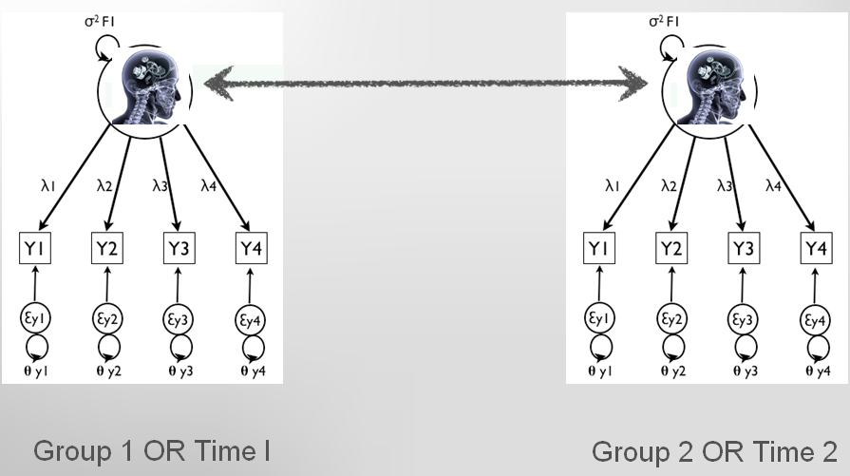
STATED DIFFERENTLY,

Slide 105
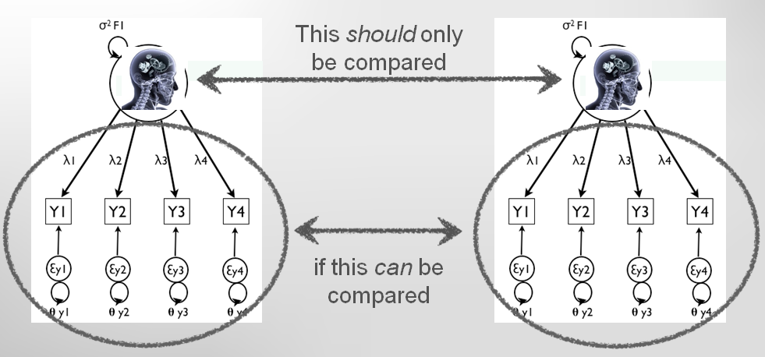
STATED DIFFERENTLY,
Van de Schoot, R., Lugtig, P., & Hox. J. (2012). A checklist for testing measurement invariance. European Journal of Developmental Psychology.

Slide 106
Item
77
extraversion
Notes:
So how does approximate MI differ from strict MI? Well, imagine an item that is developed to measure ‘depression’.
For every group that we have, we could plot the relationship between the score on the item and score on depression.

Slide 107
Group1
Item
77
extraversion
Notes:
This might look like this for one of our groups or time points. Now, in order to speak of MI, the association between the item and depression should not depend on group membership or measurement occasion. Otherwise, we would not know whether differences in group means on this item are caused by ‘real’ differences in depression or just differences in intercept or slope.

Slide 108
Group 2
Group1
Item
77
Group 3
Group 4
extraversion
Notes:
in reality, it rarely happens that this relationship is exactly the same for all groups, so you might observe something like this. For this illustration, I’ve kept the slopes equal and have varied the intercepts.

Slide 109
Group 2
Group1
Item
77
Group 3
Shift in intercepts
Group 4
extraversion
Notes:
in reality, it rarely happens that this relationship is exactly the same for all groups, so you might observe something like this. For this illustration, I’ve kept the slopes equal and have varied the intercepts.

Slide 110
Group 2
Group1
Item
77
Group 3
Group 4
extraversion
Notes:
Would we choose a random point at the x-axis, we would conclude that there are differences in depression between the groups, while their depression is actually the same.

Slide 111
The same underlying degree of extraversion
Group 2
Group1
Item
77
Group 3
Group 4
Different scores on item 77
Unfair!
extraversion
Notes:
Would we choose a random point at the x-axis, we would conclude that there are differences in depression between the groups, while their depression is actually the same.

Slide 112
Group1
Item
77
Different slopes
Group 3
Group 2
Group 4
extraversion
Notes:
If we take the shift in intercepts as an example
In the exact MI case, we would force these lines to be exactly the same, with the possible exception of one or a few extremes.

Slide 113
The same underlying degree of extraversion
Group1
Item
77
Group 3
Different scores on item 77
(differences depend on degree of extraversion)
Group 2
Group 4
extraversion
Notes:
If we take the shift in intercepts as an example
In the exact MI case, we would force these lines to be exactly the same, with the possible exception of one or a few extremes.

Slide 114
Group 2
Group1
Item
77
Group 3
Group 4
extraversion
Notes:
in reality, it rarely happens that this relationship is exactly the same for all groups, so you might observe something like this. For this illustration, I’ve kept the slopes equal and have varied the intercepts.

Slide 115
FULL MI
Group 1-4
Item
77
extraversion
Notes:
In the exact MI case, we would force these lines to be exactly the same, with the possible exception of one or a few extremes.
Now the relationship between the item and depression is the same so we can compare groups. But, the fit to our data will be bad, because we have seen that in reality, these groups differ quite a lot in this association.

Slide 116
PARTIAL MI
Group 1-3
Item
77
Group 4
extraversion
Notes:
In the exact MI case, we would force these lines to be exactly the same, with the possible exception of one or a few extremes.
Now the relationship between the item and depression is the same so we can compare groups. But, the fit to our data will be bad, because we have seen that in reality, these groups differ quite a lot in this association.
The goal of tests of partial MI is to find out which of the loadings or intercepts differ across groups. If only one of these is different across groups, we know that any differences on the latent variable can either be caused by a difference in this loading/intercept, or by the true latent variable group difference. As long as there are at least two loadings and intercepts that are constrained equal across groups, we can make valid inferences about the differences between latent factor means in the model (Byrne, Shavelson & Muthén, 1989). However, to be able to compare the sum scores or comparable observed means, we must have full scalar equivalence (Steinmetz, in press). If it can be establish which specific item is problematic, questionnaires can be altered in future (Lugtig, Boeije, & Lensvelt-Mulders 2011).

Slide 117
MEASUREMENT INVARIANCE
Exploratory approach:
Find a good factor structure
Impose constraints one-by-one
Confirmatory approaches:
Bottom-up:
Start with a CFA in each group separately
Impose equality constraints one by one (note: multiple variations on this procedure possible)
Top-down:
Assume complete measurement invariance
Check in modification indices for constraints that if released would significantly improve the model
Van de Schoot, R., Lugtig, P. & Hox, J.J. (2012). A checklist for testing measurement invariance. European Journal of Developmental Psychology, 9, 486-292. See also www.joophox.net or rensvandeschoot.com

Slide 118
Confirmatory Bottom Up Approach
General Outline
1. Have the same factor structure across groups
- No constraints, except same model structure
2. Have equal loadings across groups
3. Have equal intercepts across groups
Equivalence is vital for valid comparisons across groups
- Partial equivalence may be acceptable
Notes:
NOTE: When MI does not hold, groups or subjects over time respond differently to the items and as a consequence factor means cannot reasonably be compared.

Slide 119
Confirmatory Bottom Up Approach
Test overall model both groups combined
Test model separately for each group (configural invariance)
Must fit the data
Test equality of loadings across groups (metric/weak invariance)
Must be equal
Test equality of intercepts across groups (scalar/strict invariance)
Must be equal
Test equality of measurement error variances (strict invariance)
Not essential, often overly restrictive
Test equality of factor means/ factor variances
Notes:
Traditional MGCFA approach

Slide 120
Complete Measurement Invariance Example

Slide 121
Testing Invariance
1) test overall model
2) test model for groups separately
3) equal factor loadings (λ₁, λ₂, λ₃)
4) equal intercepts (item means) (ν₁, ν₂, ν₃)
5) equal residual variances (errors) (ε₁, ε₂, ε₃)
6) factor means and/or variances (α) (Ψ)
From Mplus version 7.1 onward, these steps can be carried out in a “single” analysis rather than comparing multiple models
Ψ
α
F1
λ₁
λ₂
λ₃
y₁
y₂
y₃
1
1
1
0
0
0
e₁
e₂
e₃
ε₁
ε₂
ε₃
Notes:
Factor loadings => tests whether respondents across groups attribute the same meaning to the latent construct under study
Intercepts => tests whether the meaning of the levels of the underlying items (intercepts) are equal in both groups.
Residual variances => If error variances are not equal, groups can still be compared on the latent variable, but this is measured with different amounts of error between groups.

Slide 122
MPLUS SYNTAX
TITLE: MI test SEM;
DATA: FILE IS Sapi_Demo.dat;
VARIABLE: NAMES = ID Age EduLevel Gender ReadAb Q44 Q63 Q76 Q77 Q84 Q98 Q170 Q196;
USEVARIABLES = Q77 Q84 Q196 Q44 Q63 Q98;
GROUPING = Gender (1 = males 2 = females);
MISSING = ALL(-999);
ANALYSIS: MODEL = CONFIGURAL METRIC SCALAR;
MODEL: FUN BY Q77 Q84 Q196;
LIKED BY Q44 Q63 Q98;
OUTPUT: SAMPSTAT TECH1;

Slide 123
MEASUREMENT INVARIANCE OUTPUT
MODEL FIT INFORMATION
Invariance testing
…
Degrees of
Models Compared Chi-square Freedom P-value
Metric against Configural 1.399 4 0.8443
Scalar against Configural 8.778 8 0.3613
Scalar against Metric 7.379 4 0.1172
Metric Invariance model fits just as well as the Configural Invariance model
The Scalar Invariance model also fits just as well as the Metric Invariance model.

Slide 124
MEASUREMENT INVARIANCE OUTPUT
MODEL FIT INFORMATION
Invariance testing
…
Degrees of
Models Compared Chi-square Freedom P-value
Metric against Configural 1.399 4 0.8443
Scalar against Configural 8.778 8 0.3613
Scalar against Metric 7.379 4 0.1172
If the tests were significant, then we may try to find source of bias with modification indices.
Then continue with MI tests with the source of bias freely estimated between groups (aiming for partial MI)

Slide 125
MEASUREMENT INVARIANCE OUTPUT
MODEL FIT INFORMATION
Invariance testing
…
AIC BIC Configural 15354.39 15540.16
Metric 15347.79 15514.00
Scalar 15347.17 15493.83

Slide 126
MEASUREMENT INVARIANCE OUTPUT
MODEL FIT INFORMATION
Invariance testing
…
AIC BIC Configural 15354.39 15540.16
Metric 15347.79 15514.00
Scalar 15347.17 15493.83

Slide 127
MEASUREMENT INVARIANCE OUTPUT
CONFIGURAL
CFI 0.939
RMSEA 0.094
METRIC
CFI 0.942
RMSEA 0.082
SCALAR
CFI 0.939
RMSEA 0.077
Notes:
The default statistic to compare models is the chi-square test, but is dependent on the sample size: it rejects reasonable models if sample is large and it fails to reject poor models if sample is rather small.
There are other types of fit indices that can be used to assess MI:
comparative fit index (CFI),
root mean squared error of approximation (RMSEA),
and other fit measure comparisons [14, 15]
See:
Cheung, G. W., & Rensvold, R. B. (2002). Evaluating goodness-of-fit indexes for testing measurement invariance. Structural Equation Modeling, 9(2), 233–255. doi:10.1207/S15328007SEM0902_5
Chen, F. F. (2007). Sensitivity of goodness of fit indexes to lack of measurement invariance. Structural Equation Modeling, 14(3), 464–504. doi:10.1080/10705510701301834

Slide 128
FURTHER READING
Van de Schoot, R., Lugtig, P., & Hox. J. (2012). A checklist for testing measurement invariance. European Journal of Developmental Psychology, 9, 486-492.
Vandenberg, R.J., & Lance, C.E. (2000). A review and synthesis of the measurement invariance literature: Suggestions, practices, and recommendations for organizational research, Organizational Research Methods, 3, 4-70
Byrne, B.M., Shavelson, R.J., & Muthén, B.O. (1989). Testing for equivalence of factor covariance and mean structures: The issue of partial measurement invariance. Psychological Bulletin, 105, 456-466
Foundational Work
Jöreskog, K.G. (1971). Simultaneous factor analysis in several populations. Psychometrika, 36, 409-426

Slide 129


WHEN MI DOES NOT HOLD….
On war mission
Distress before
Distress after
Lommen, M. J. J., van de Schoot, R., & Engelhard, I. M. (2014). The experience of traumatic events disrupts the measurement invariance of a posttraumatic stress scale. Frontiers in Psychology.
Notes:
From the article: “The experience of a traumatic event can influence one’s view of the world, others, and self, and may disrupt the stability of a questionnaire measuring posttraumatic stress symptoms.
The measure of post-traumatic stress is a nice example since from a theoretical perspective you expect that it lacks measurement invariance

Slide 130
More Interesting reading
Van De Schoot, R., Kluytmans, A., Tummers, L., Lugtig, P., Hox, J., & Muthén, B. (2013). Facing off with Scylla and Charybdis: A comparison of scalar, partial, and the novel possibility of approximate measurement invariance. Frontiers in Psychology, 4
Fox, J.-P., & Verhagen, A. J. (2010). Random item effects modeling for cross-national survey data. In E. Davidov, P. Schmidt, & J. Billiet (Eds.). Cross-cultural analysis: Methods and applications (pp. 467-488). London, UK: Routledge Academic.
Davidov, E., Dülmer, H., Schlüter, E., Schmidt, P., & Meuleman, B. (2012). Using a multilevel structural equation modeling approach to explain cross-cultural measurement noninvariance. Journal of Cross-Cultural Psychology, 43(4), 558–575.
Muthén, B., and Asparouhov, T. (2013). BSEM Measurement Invariance Analysis. Mplus Web Notes: No. 17. Available online at: www.statmodel.com
Notes:
Many studies examining MI of survey scales have shown that the MI assumption is very hard to meet. In particular, strict forms of MI rarely hold. With “strict” we refer to a situation in which measurement parameters are exactly the same across groups or measurement occasions, that is an enforcement of zero tolerance with respect to deviations between groups or measurement occasions.
According to the advocates of approximate measurement invariance, exact zero constraints are overly strict, especially when there are many groups or time points involved (e.g., [22]). One consequence is a frequent rejection of the exact invariance model, even when the parameter differences are ignorable (i.e., the second strategy). Another consequence is often a large series of model modifications that may capitalize on chance [23]. In approximate measurement invariance, small differences in parameters are allowed.

